Slide 1
Insurance Coverage and Fertility-Related Medical Help
Evidence from the 2022 - 2023 National Survey of Family Growth
Gracie Nguyen
DATA 400 Individual Mini-Project · Dickinson College

Slide 2
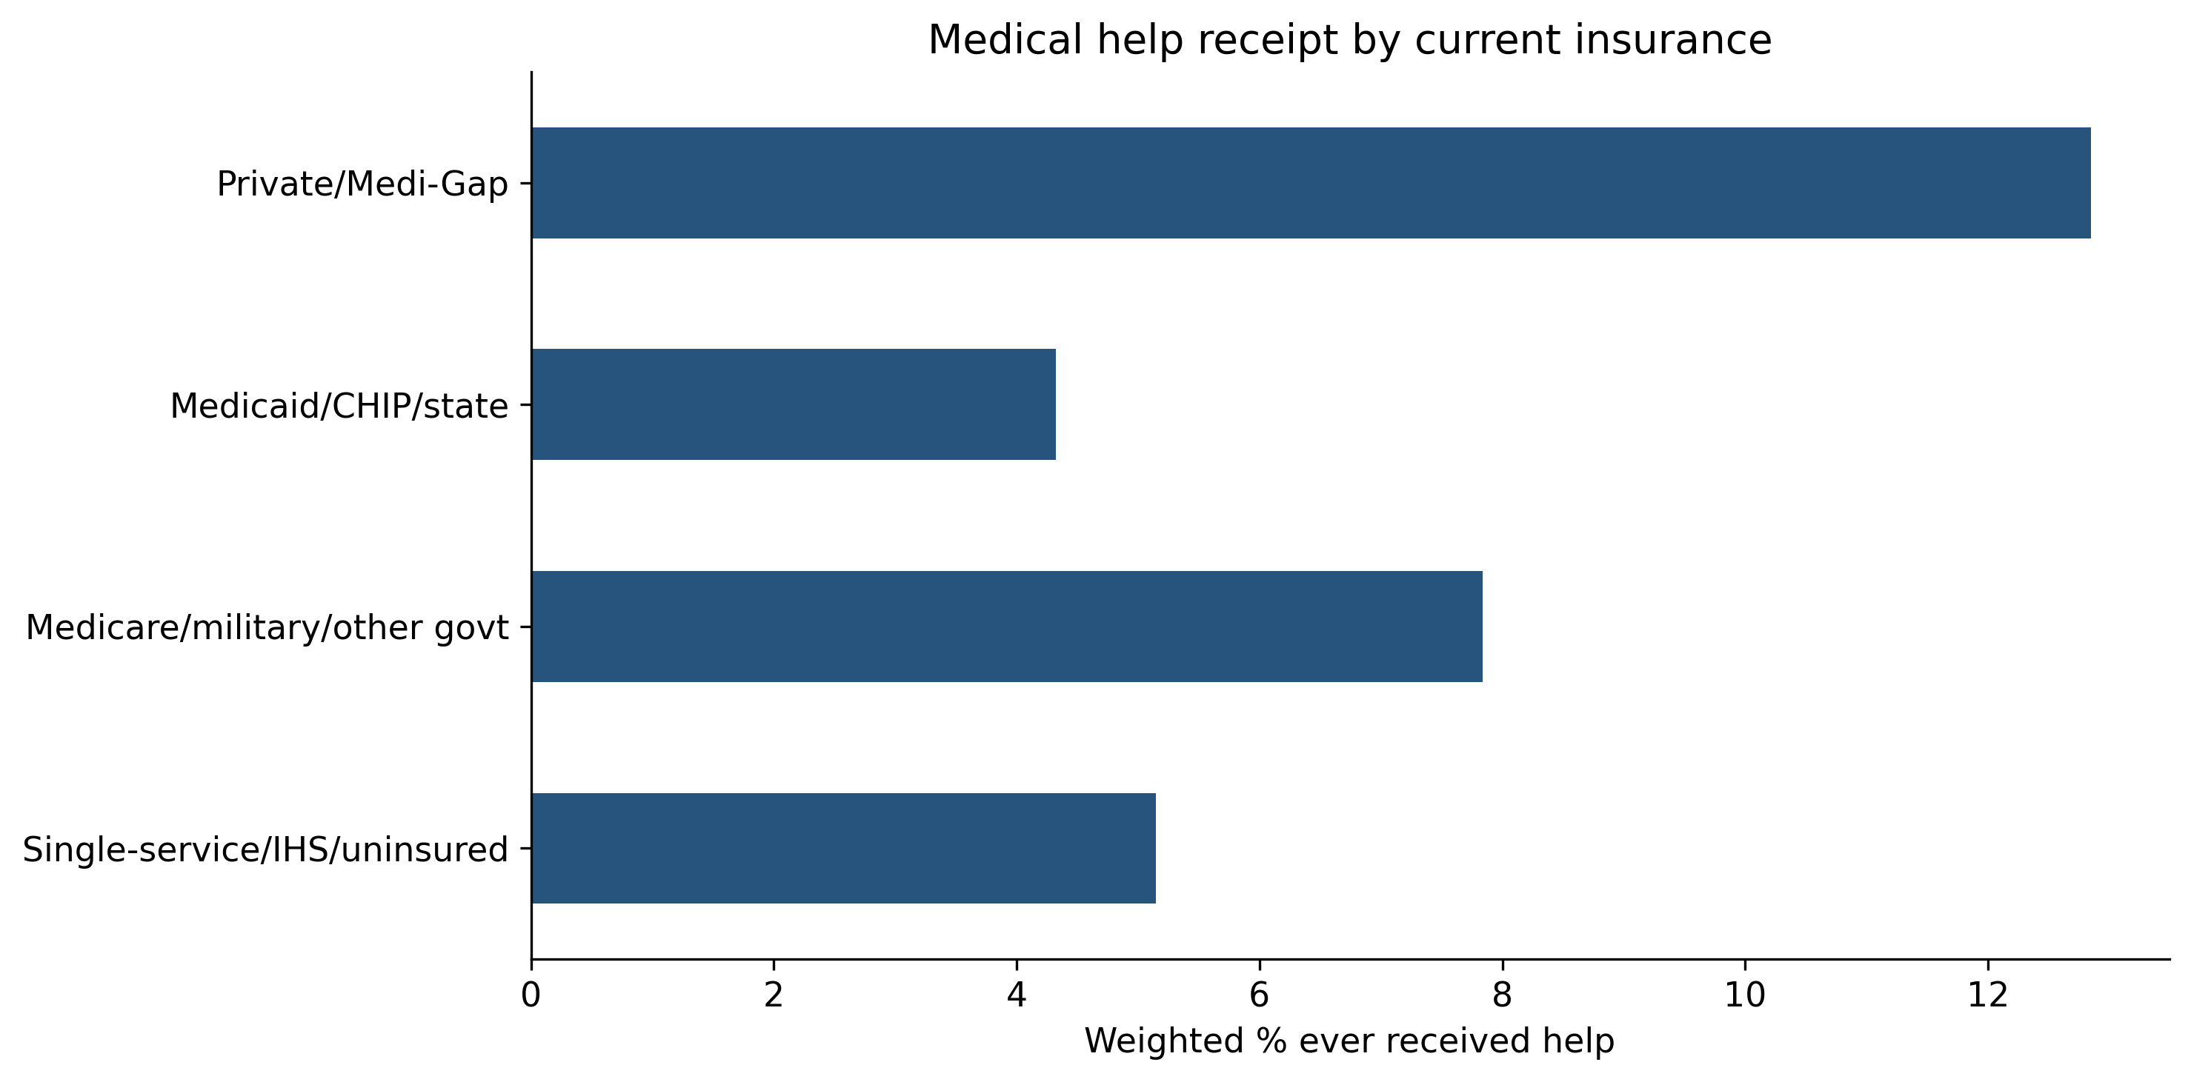
Help Receipt Differs Across Insurance Groups
Weighted percentage ever receiving medical help
Private
12.9%
Medicaid/CHIP/state
4.3%
Difference:
~8.5 percentage points

Slide 3
Research Question
Is current insurance type associated with ever receiving medical help to become pregnant,
after accounting for age, income, and education?

Slide 4
Why This Question Matters
1
Insurance coverage may influence the affordability of medical care.
2
Income and education may also shape care use.
3
Differences in fertility-related care receipt matter to reproductive-health researchers and advocates.
Focus: Whether an insurance association remains after socioeconomic adjustment.

Slide 5
Data and Measures
Source: CDC/NCHS, NSFG 2022-2023 Female Respondent Public-Use File
Role | Measure
Outcome | Ever received medical help to become pregnant: yes/no
Main predictor | Current insurance type*
Controls | Age, income relative to poverty threshold, education
Survey information | Analysis weights, strata, and clusters
5,586
Original sample: respondents
5,195
Analysis sample: respondents
*Coverage groups: Private/Medi-Gap, Medicaid/CHIP/state, other government, and single-service/IHS/uninsured.

Slide 6
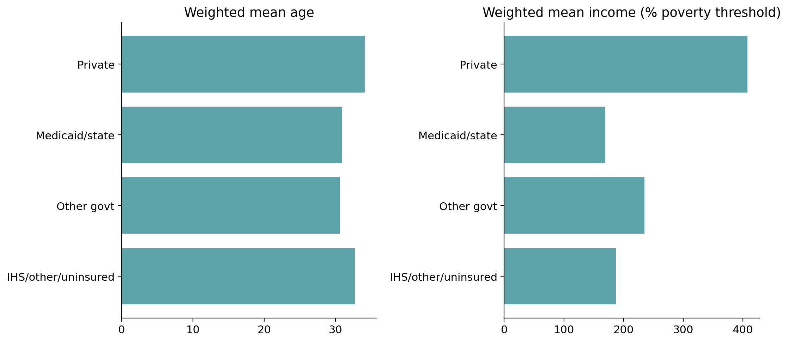
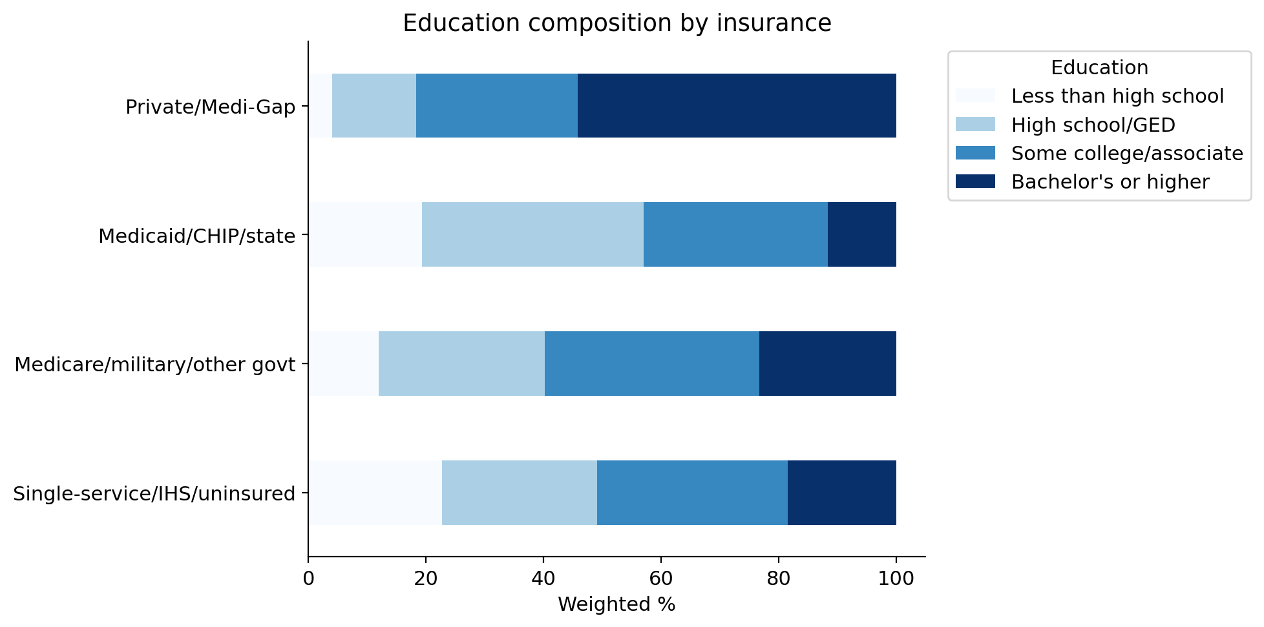
Could Differences in Age, Income, and Education Help Explain the Gap?
Characteristic | Private | Medicaid/CHIP/state
Mean age | 34.1 | 30.9
Mean income as % of poverty threshold | 407% | 168%
Bachelor’s degree or higher | 54.2% | 11.7%
These differences motivate statistical adjustment.

Slide 7
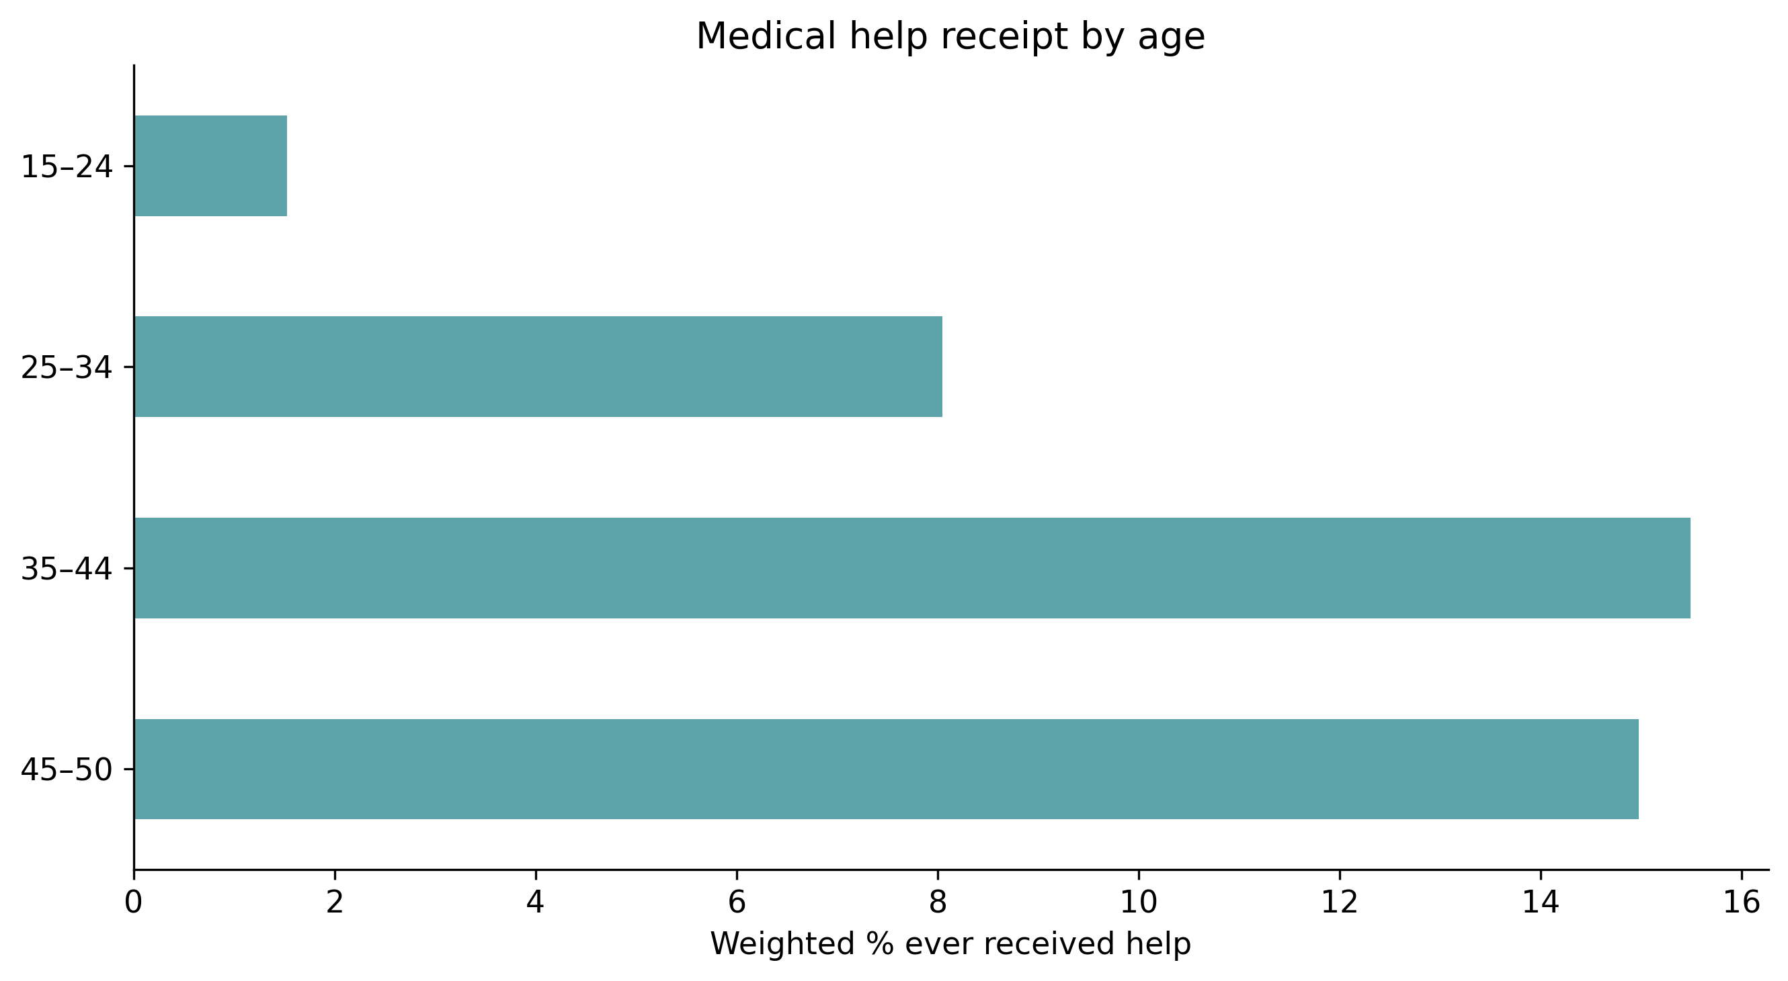
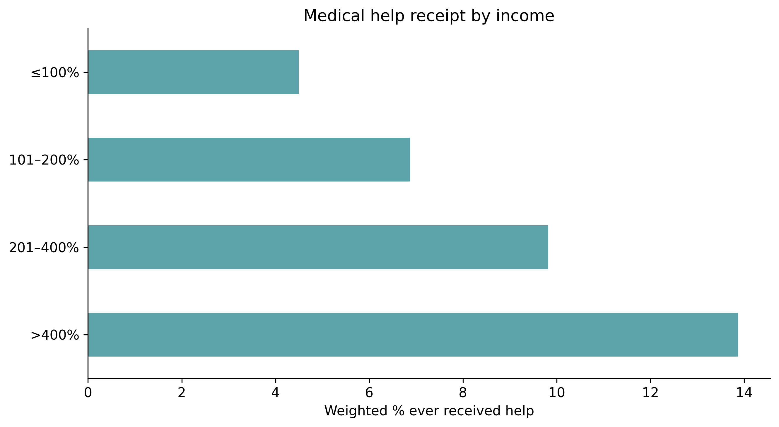
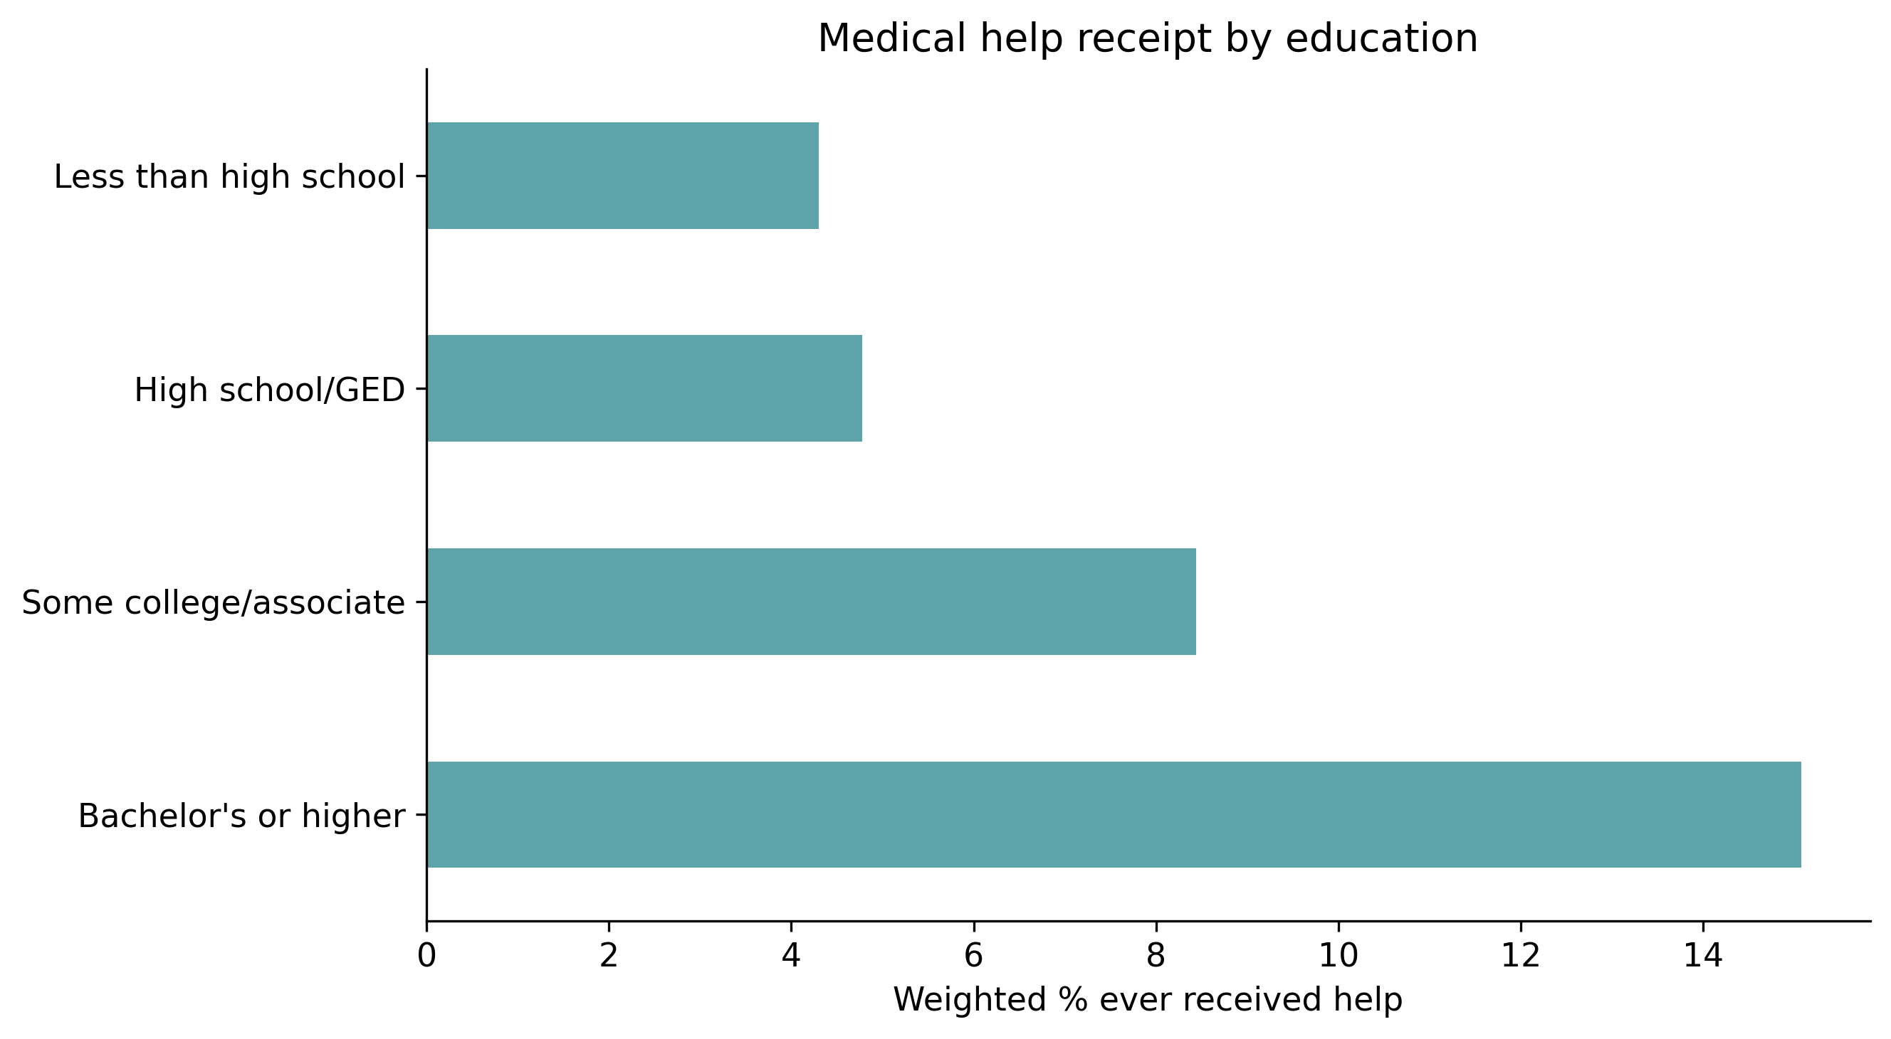
Help Receipt Also Varies with
Age, Income, and Education
Age
Income
Education
1.5% at 15 - 24,
compared with 15.5% at 35 - 44
4.5% at ≤100% of poverty, compared with 13.9% above 400%
4.3% below high school, compared with 15.1% for bachelor’s or higher

Slide 8
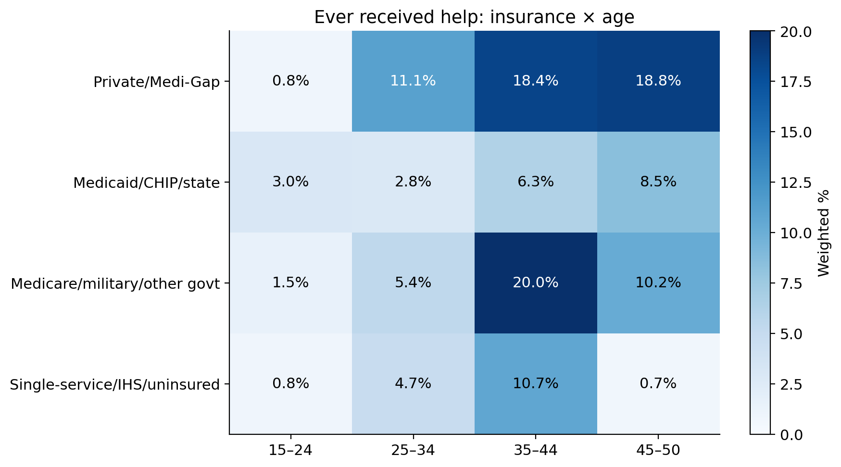
The Insurance Pattern Within Age Groups
Age group | Private | Medicaid/ CHIP/state
25 - 34 | 11.1% | 2.8%
35 - 44 | 18.4% | 6.3%
45 - 50 | 18.8% | 8.5%
Exception at 15 - 24: Medicaid respondents have the higher rate. Some cells are small.
Private coverage has higher rates within each age group from age 25 onward.

Slide 9
Statistical Approach
Survey-weighted logistic regression
Odds ratio interpretation
Model component | Specification
Outcome | Ever received medical help: 1 = yes, 0 = no
Main predictor | Current insurance category
Controls | Age, income, education
Insurance reference | Private/Medi-Gap
Education reference | Less than high school
1
Equal odds relative to the reference
< 1
Lower odds
> 1
Higher odds
For example, value below one indicates that a respondent is less likely to report receiving help, conditional on the model’s other variables.

Slide 10
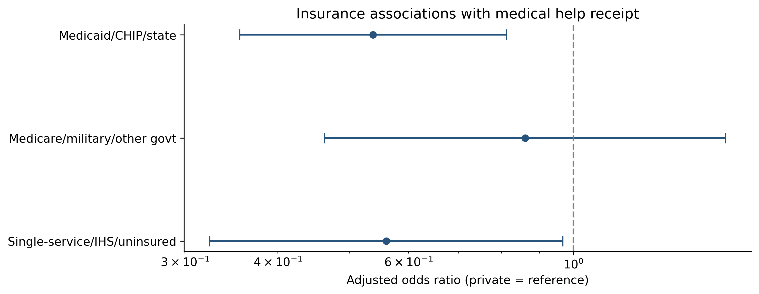
Differences Remain After Accounting for Age, Income, and Education
Vs. private | Adj. OR | 95% CI
Medicaid/CHIP/state | 0.54 | 0.36 - 0.81
Other government | 0.86 | 0.46 - 1.60
Single-service/IHS/uninsured | 0.56 | 0.32 - 0.97
Before vs. after controls
Coverage | Before | After
Medicaid/CHIP/state | 0.31 | 0.54
Other government | 0.58 | 0.86
Single-service/IHS/uninsured | 0.37 | 0.56

Slide 11
Prior Research and Study Limitations
Comparison with Eliason et al. (2023)
Key limitations
Earlier NSFG data: 2002–2019
Main outcome: past-year fertility-service use
Main population: respondents currently trying to conceive
Similar direction of the Medicaid - private disparity
Current coverage may differ from coverage when care occurred.
Respondents have different fertility needs and intentions.
Observational data leave alternative explanations.

Slide 12
Insurance Differences Remain After Selected Controls
1
Private coverage has the highest unadjusted help-receipt rate.
2
Medicaid/CHIP/state and single-service/IHS/uninsured coverage retain lower adjusted odds.
3
Further research should examine coverage at the time of care and differences in fertility need.
The findings describe associations in reported lifetime care receipt.

